Slide 1
Cloud services for developers joe Blackett

Slide 2
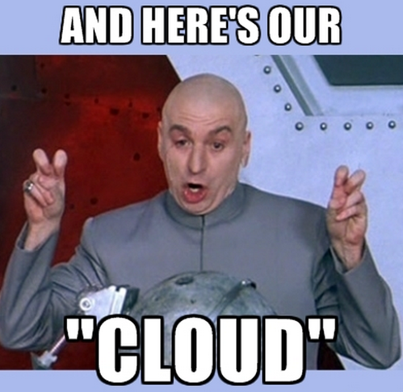
What is cloud?

Slide 3


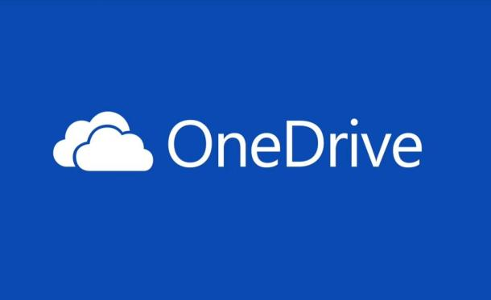



Here are some clouds

Slide 4
Cloud for developers
BaaS
  Backend as a Service
SaaS
  Software as a Service
PaaS
  Platform as a Service
IaaS
  Infrastructure as a Service

Slide 5

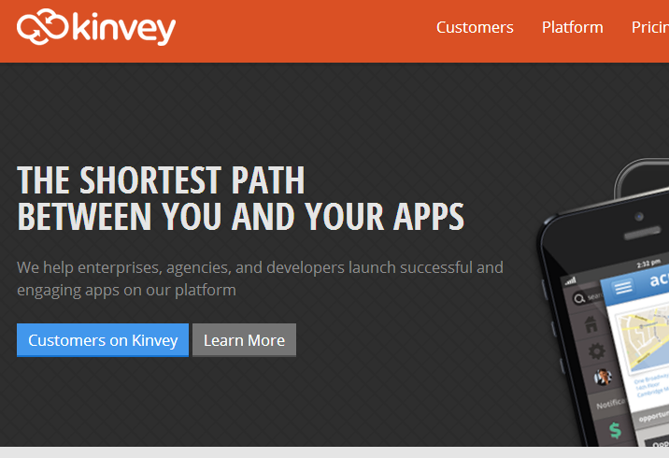
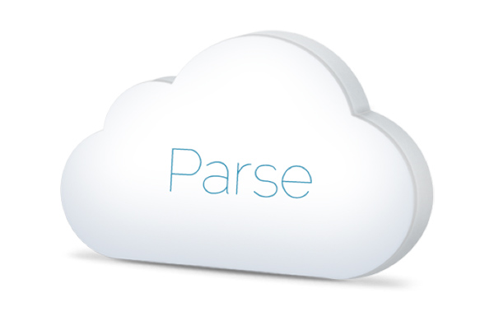
BaaS / MBaaS
Not David Baas

Slide 6

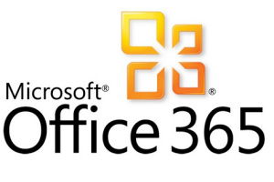


SaaS

Slide 7
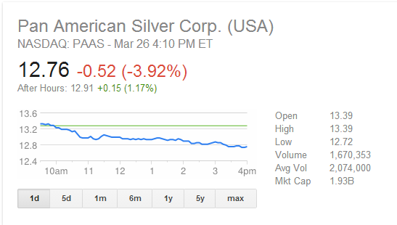

PaaS
Not the Pan American Silver Corp
Multi-Tenancy

Slide 8
IaaS
Some info

Slide 9
Your Title
Some info

Slide 10
Your Title
Some info

Slide 11
Your Title
Some info

Slide 12
Your Title
Some info

Slide 13
Your Title
Some info

Slide 14
Your Title
Some info

Slide 15
Your Title
Some info

Slide 16
Your Title
Some info

Slide 17
Your Title
Some info

Slide 18
Your Title
Some info

Slide 19

Sources (list them)
http://www.google.com
http://www.kinvey.com/
https://parse.com/
https://plex.tv/
http://apprenda.com/library/paas/iaas-paas-saas-explained-compared/

